Slide 1
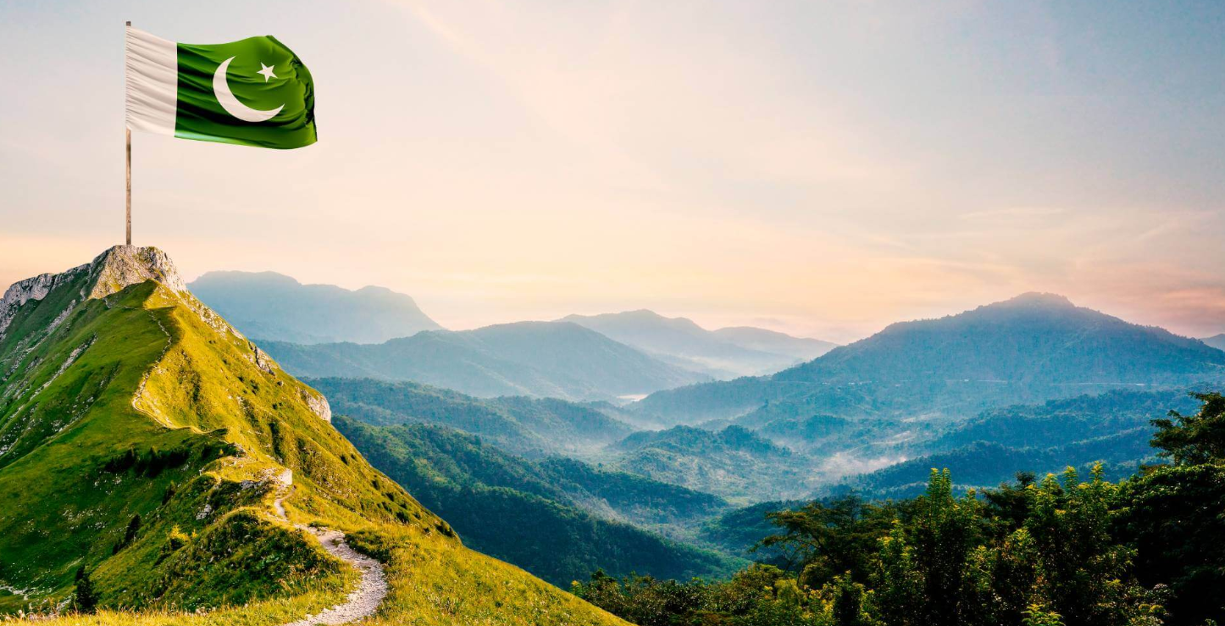
ALL ABOUT PAKISTAN
Pakistan, officially the Islamic Republic of Pakistan, is a country in South Asia. It is the fifth-most populous country, with a population of over 241.5 million, having the second-largest Muslim population as of 2023. Islamabad is the nation's capital, while Karachi is its largest city and financial centre.
Capital: Islamabad
Official languages: Urdu, English
Gross domestic product: 338.4 billion USD (2023) World Bank
Government: Federal republic, Parliamentary republic
President: Asif Ali Zardari
Population: 240.5 million (2023) World Bank
Dialing code: +92

Slide 2
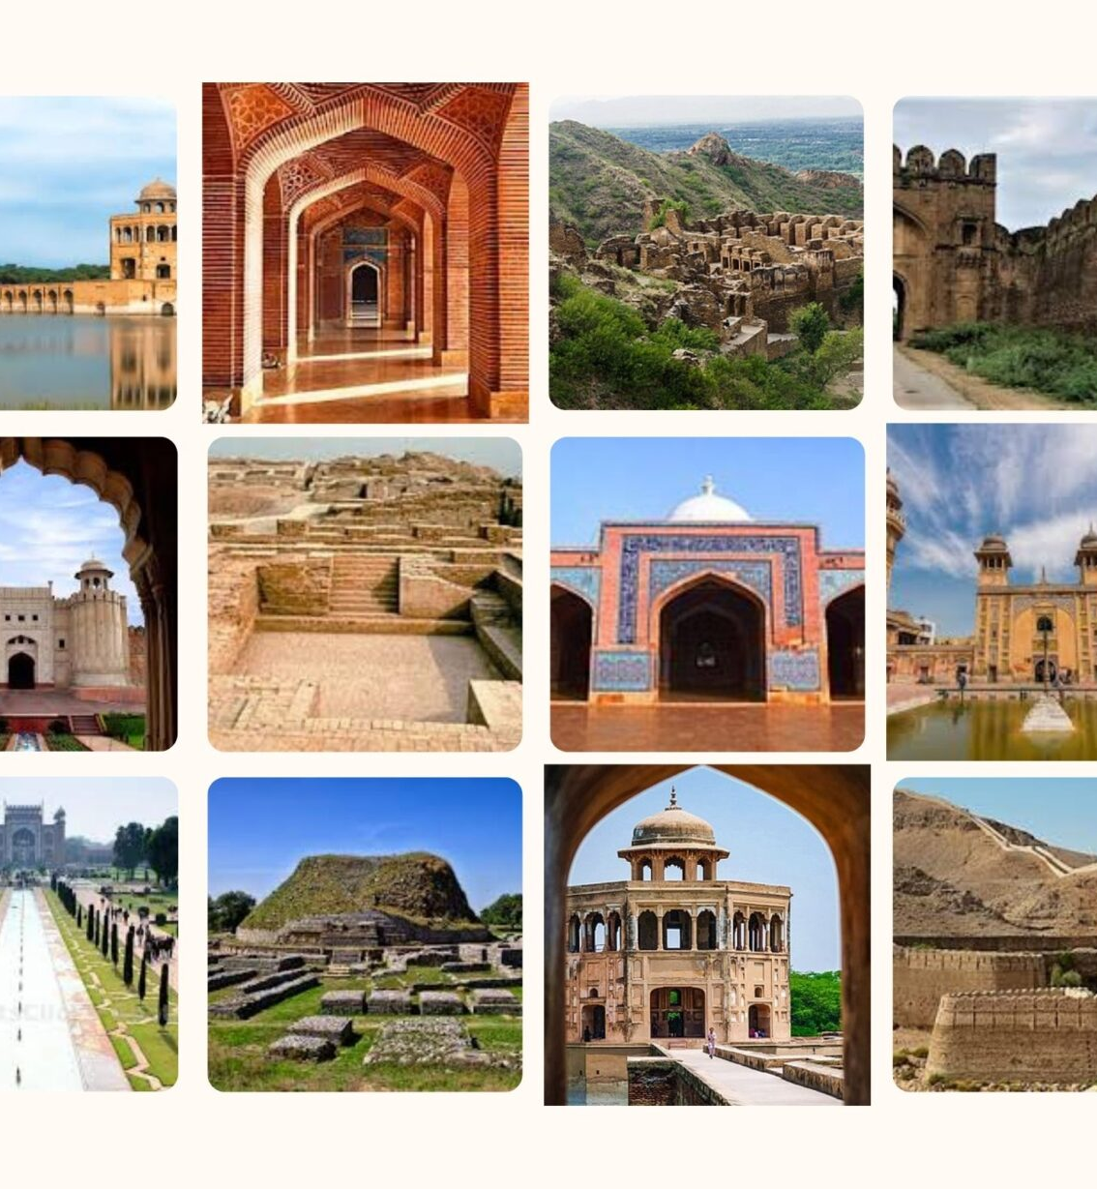
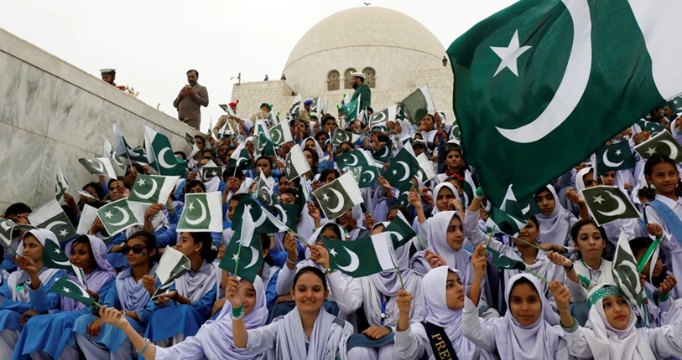

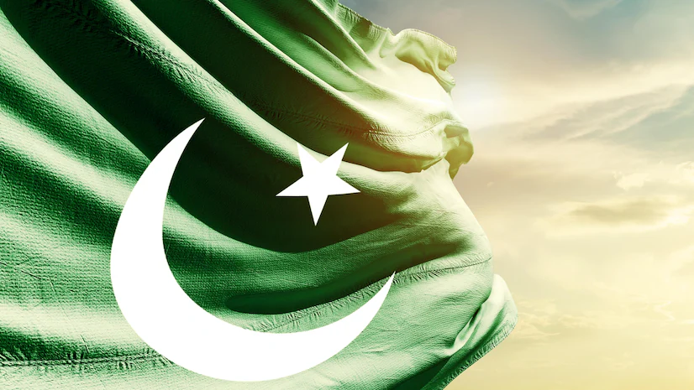
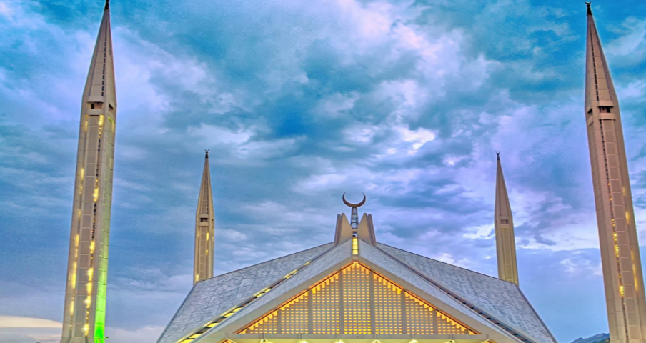
SOME IMAGES

Slide 3
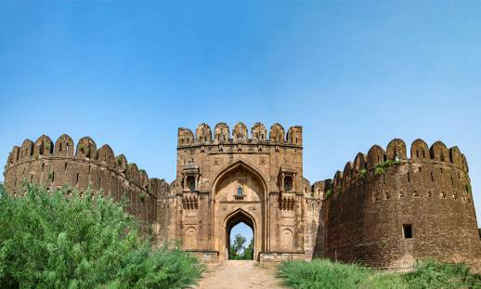
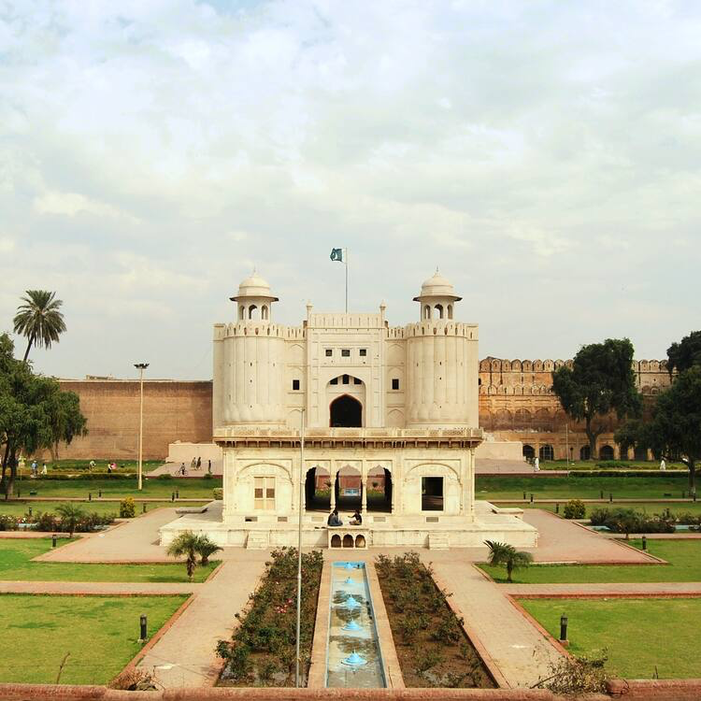
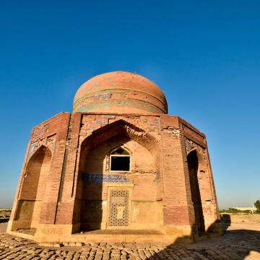
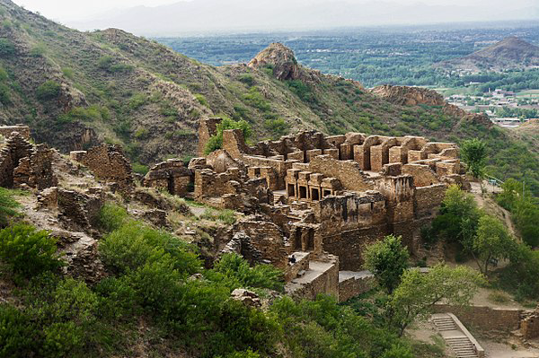
HISTORICAL PLACES IN PAKISTAN
1
Buddhist Ruins of Takht-i-Bahi and Neighbouring City Remains at Sahr-i-Bahlol | Khyber Pakhtunkhwa | 1980
Historical Monuments at Makli, Thatta | Sindh | 1981
Fort and Shalimar Gardens in Lahore | Punjab | 1981
Rohtas Fort | Punjab | 1997
2
3
4

Slide 4
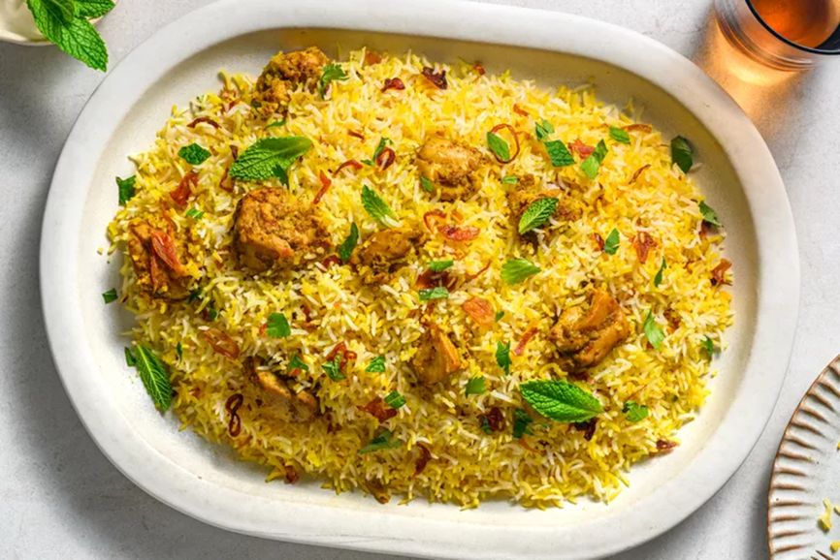
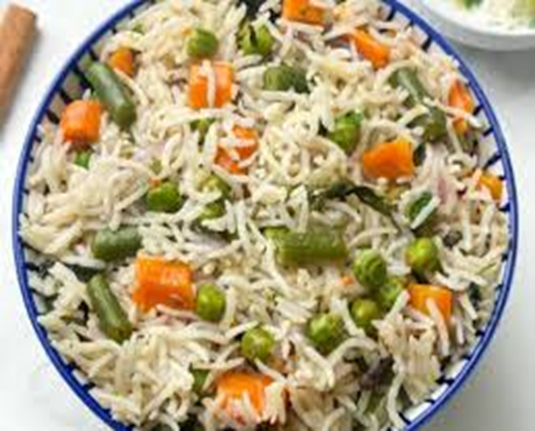
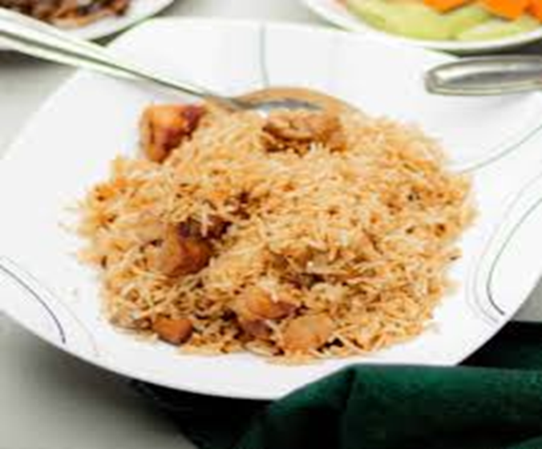
BIRYANI
PULAO
Biryani and Pulao is a mixed rice dish, mainly popular in South Asia. It is mainly meat and lots of seasonings and spices. To cater to vegetarians in some cases, it is prepared by substituting vegetables or paneer for the meat. Sometimes eggs or potatoes are also added.

Slide 5
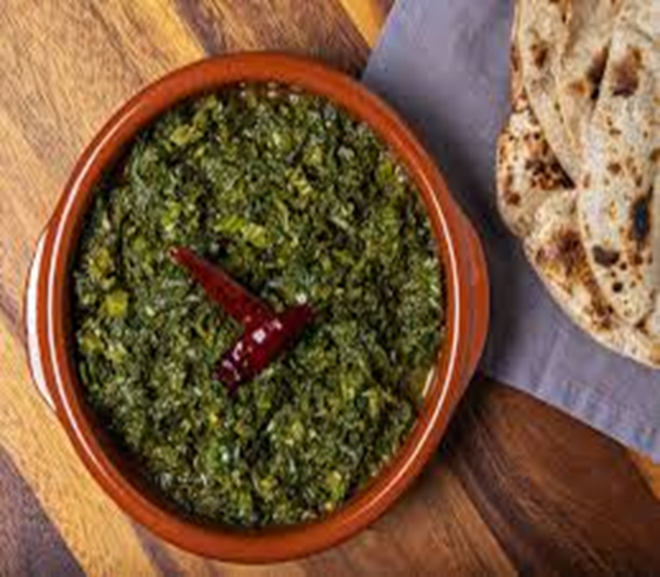
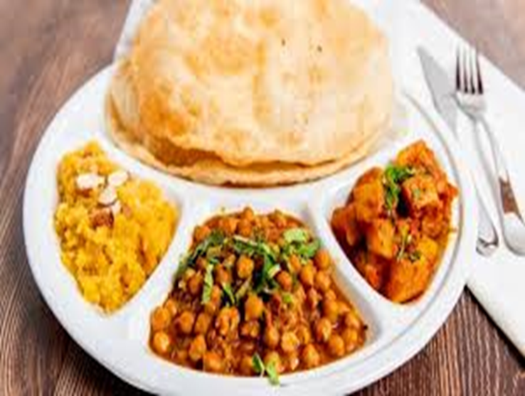
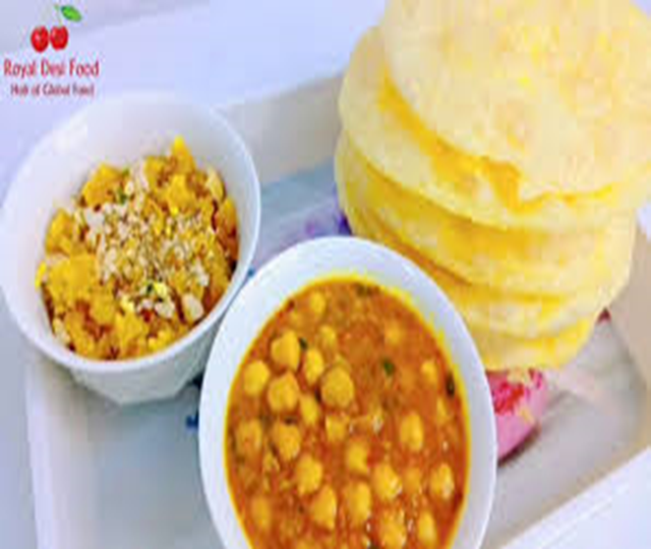
Halwa Puri
Saag
Halwa Puri is one of the most popular comfort foods in Pakistan. It's made with a sweet semolina pudding called Halwa and a fried dough called Puri and is a combination of Chana Curry masala and a deep-fried bread made from maida. Usually used in Breakfast.
Saag also spelled sag or saga, is an Punjabi leafy vegetable dish eaten with bread, such as roti or naan, or in some regions with rice. Saag can be made from mustard greens, collard greens, basella or finely chopped broccoli along with added spices and sometimes other ingredients, such as chhena. Saag. When it comes to vegetable dishes in Pakistan, 'Saag' is much cherished. Made from mustard leaves, methi, and spinach.

Slide 6


